Slide 1
DNA
At the completion of this unit, students will be able to:
Explain how the structure of DNA relates to its function
Identify the scientists who discovered the DNA structure
Model and label the basic structure of DNA
Describe the process of DNA replication
Describe the steps of translation and transcription in changing DNA into traits
DNA Intro Video

Slide 2
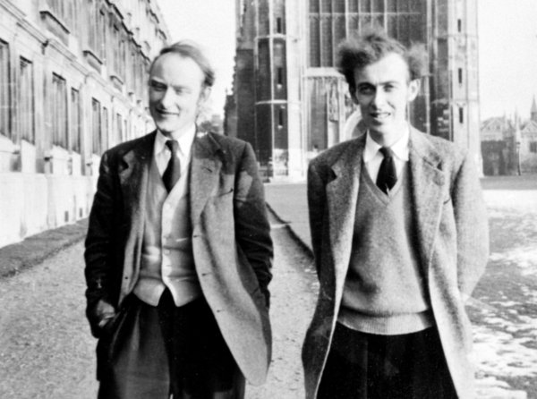
Discovery of DNA
Identify the scientists who discovered the DNA structure
WATSON and CRICK
In 1953
At Cambridge University in England

Slide 3
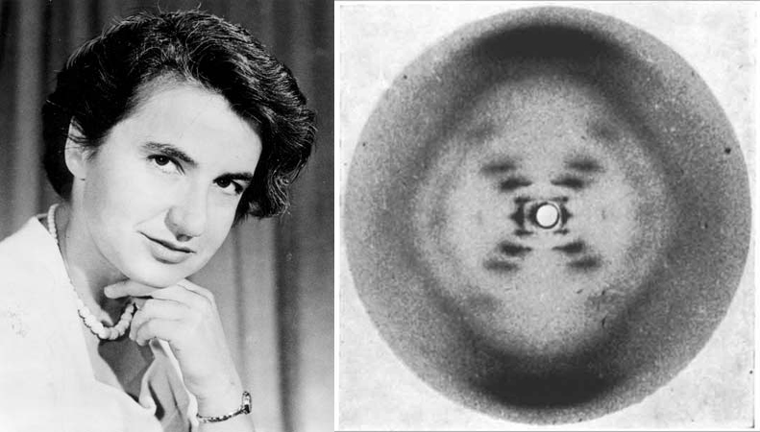
Rosalind Franklin
Structure discovery possible because of X-Ray Crystallography pictures taken by Rosalind Franklin (taken without her permission)

Slide 4
DNA Structure
B. Model and label the basic structure of DNA
Deoxyribo
Nucleic
Acid
The hereditary molecule controlling the activities of the cell

Slide 5
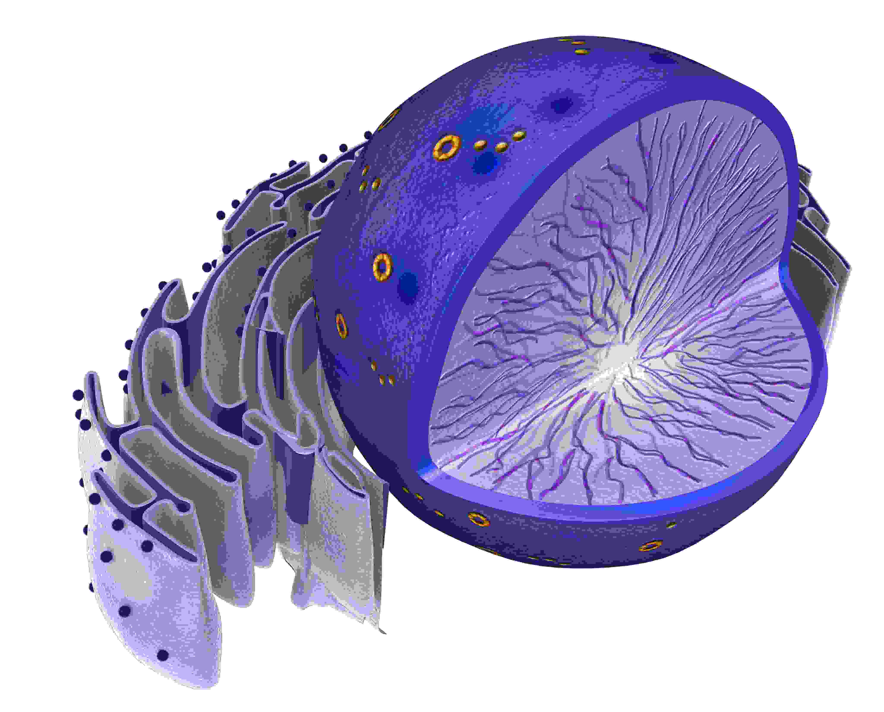
Found in the Nucleus

Slide 6
DNA Structure
NUCLEOTIDE
The BUILDING block of the DNA ladder

Slide 7
NUCLEOTIDE
Composed of
PHOSPHATE
DEOXYRIBOSE SUGAR
NITROGENOUS BASE

Slide 8
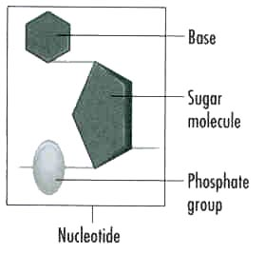
NUCLEOTIDE

Slide 9
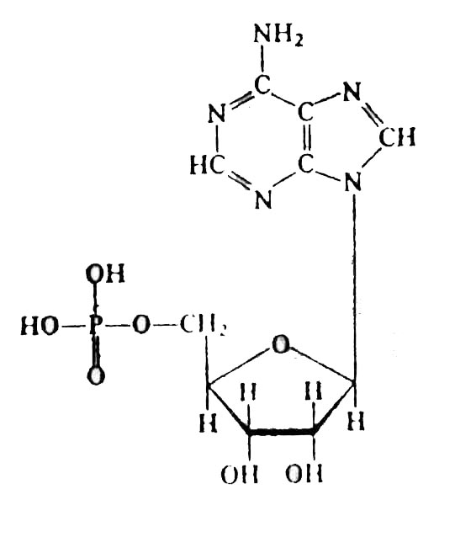
NUCLEOTIDE

Slide 10
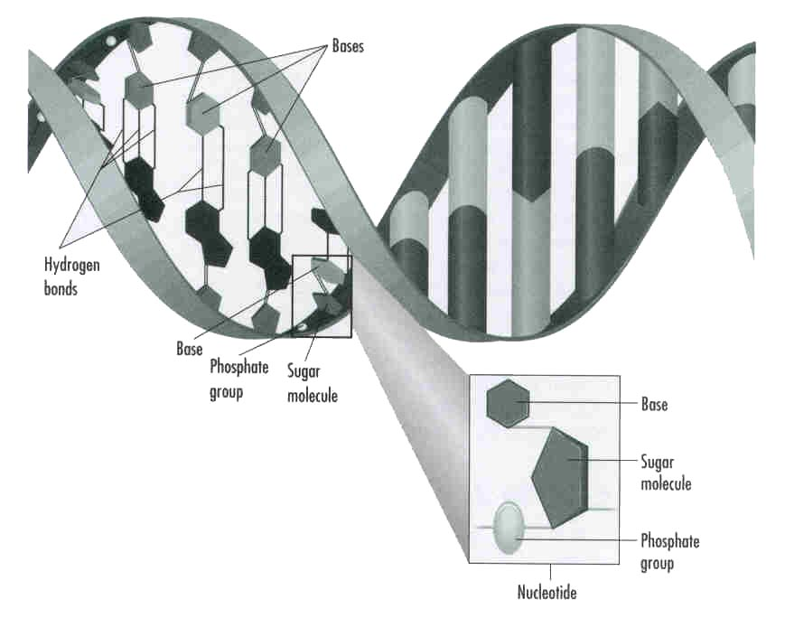

Slide 11
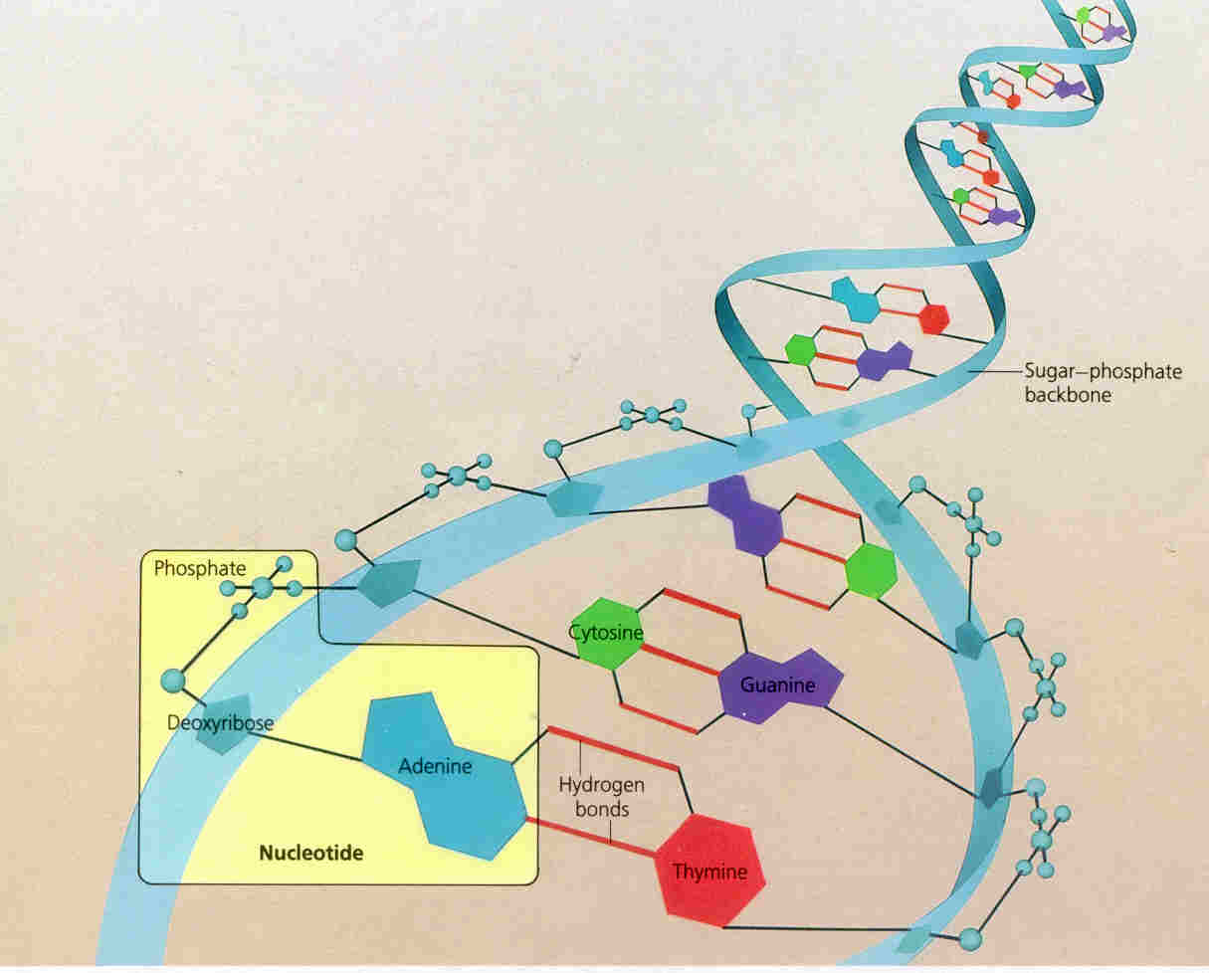

Slide 12
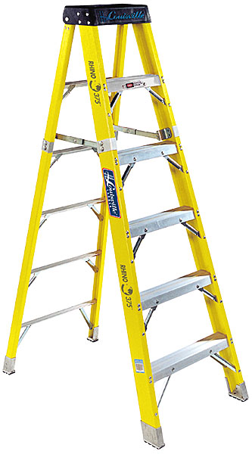
DNA Structure
B. Model and label the basic structure of DNA
Ladder Rungs:
Nitrogenous Bases
Side of Ladder:
Sugar Phosphate Backbone
(A Spiral ladder)
“DOUBLE HELIX”

Slide 13
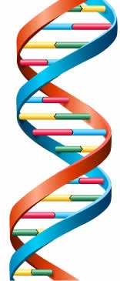
DNA Structure
B. Model and label the basic structure of DNA
Double Helix
Sugar Phosphate Backbone
Nitrogenous Base
Base Pair

Slide 14
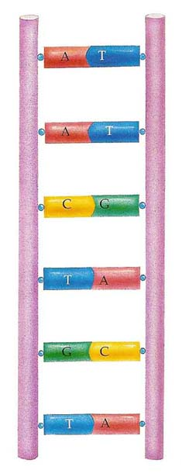
DNA Structure
B. Model and label the basic structure of DNA
4 Nitrogenous Bases:
(A) Adenine
(T) Thymine
(G) Guanine
Cytosine
ALWAYS Pair
ALWAYS Pair

Slide 15
DNA Structure
B. Model and label the basic structure of DNA
How do the base pairs connect?
Hydrogen Bond

Slide 16
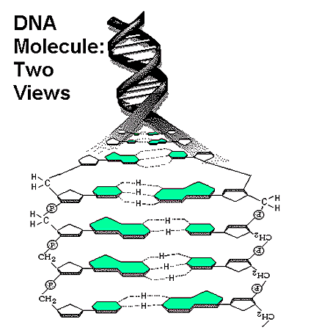
Hydrogen Bond
Nucleotide
Phosphate Group
Nitrogenous Base
Deoxyribose Sugar
Base Pair

Slide 17
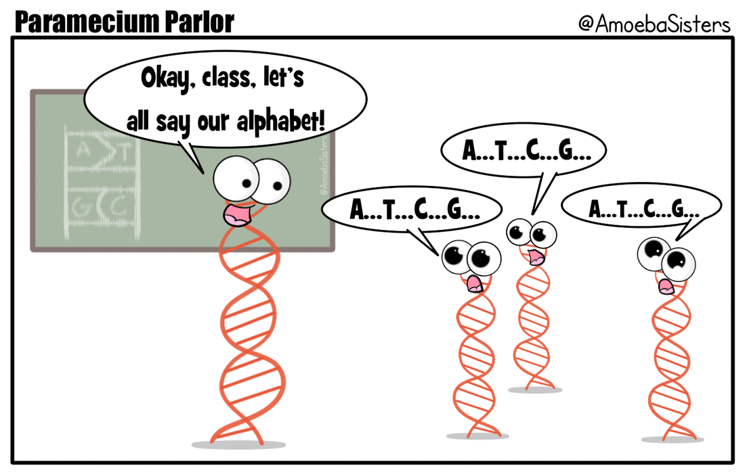
Are you with me??
B. Model and label the basic structure of DNA
Which of the following has the correct base pair matches?
A T C C G T
T C G G C C
T T C G G A
A C G C C T
T C G C G A
A G C G C T
C G T A T C
G C A A A G

Slide 18
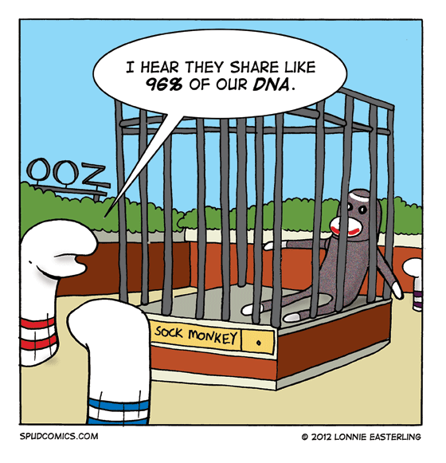
In a Single Cell
6 feet of DNA.
3 billion base pairs
Humans DNA is 99.9% identical.
So, how does it all fit????

Slide 19
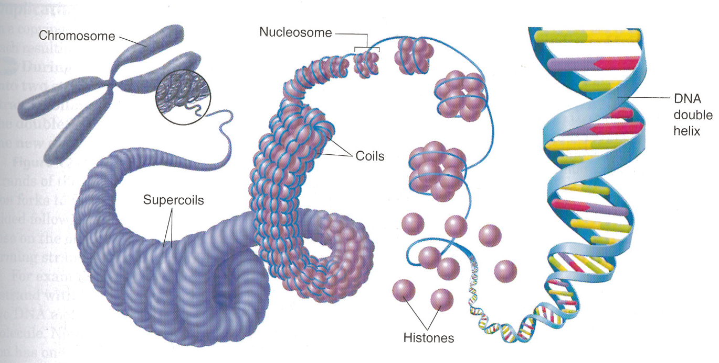
DNA Structure
B. Model and label the basic structure of DNA

Slide 20
DNA Function
Carry Genetic information
It is a CODE that tells the cell which proteins to make

Slide 21
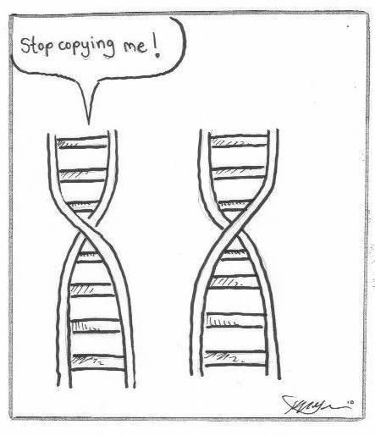
DNA Replication
C. Describe the process of DNA replication
Producing a new copy of an organisms genetic information.
Cells Replicate their DNA when they get ready to divide
Why would DNA need to be replicated?

Slide 22
DNA Replication
C. Describe the process of DNA replication
What is DNA Replication?
Making an exact copy of a DNA molecule
Happens during Interphase
Occurs in the Nucleus
Essential in maintaining the correct chromosome number in cell division

Slide 23
DNA Replication
C. Describe the process of DNA replication
Step #2:
Free Nucleotides pair with bases on original
Step #1:
Original DNA unzips
Step #3:
2 identical DNA molecules are formed

Slide 24
Are you with me?
C. Describe the process of DNA replication
During replication, what ensures that both DNA molecules are EXACTLY the same?
Sugar phosphate backbone is created the same
Phosphate bases are dissolve during mitosis
Base pairs always match. (A’s with T’s & C’s with G’s)
They aren’t the same, this is how genetic variation is achieved from parent to offspring.

Slide 25
DNA Replication Bracelet
C. Describe the process of DNA replication
In a teams of 2…
Choose 12 random beads of 4 colors.
The beads represent bases, so choose which color of beads will represent which base. Write the key on your lab sheet.
EX – A=Blue, T=Pink, G=Yellow, C= Orange
Slide the beads (bases) onto the pipe cleaner in random order.
Select a different pipe cleaner.
Select 18 more beads based to MATCH the pattern you created with your first strand.
Twist the pipe cleaners together to create the DNA double helix structure.
Turn the double helix into a circle creating 1 bracelet.

Slide 26
DNA Replication Bracelet
C. Describe the process of DNA replication
Now copy your DNA bracelet…
Untwist your DNA Bracelet
Get 2 more pipe cleaners
Create a copy for each side of the bracelet
Twist the bracelets together so you have 2 exact copies

Slide 27
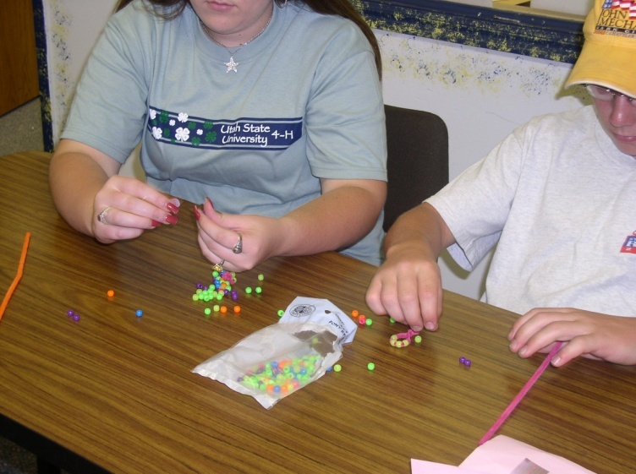
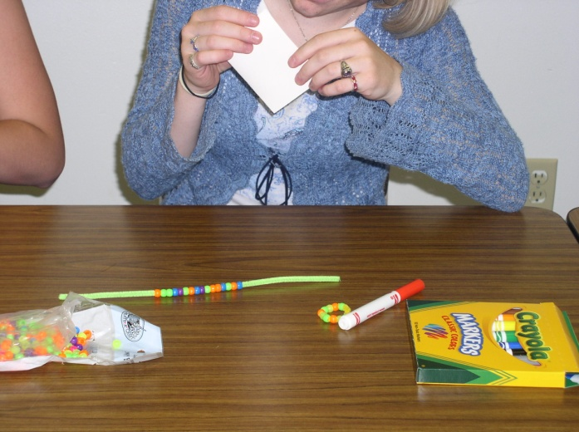
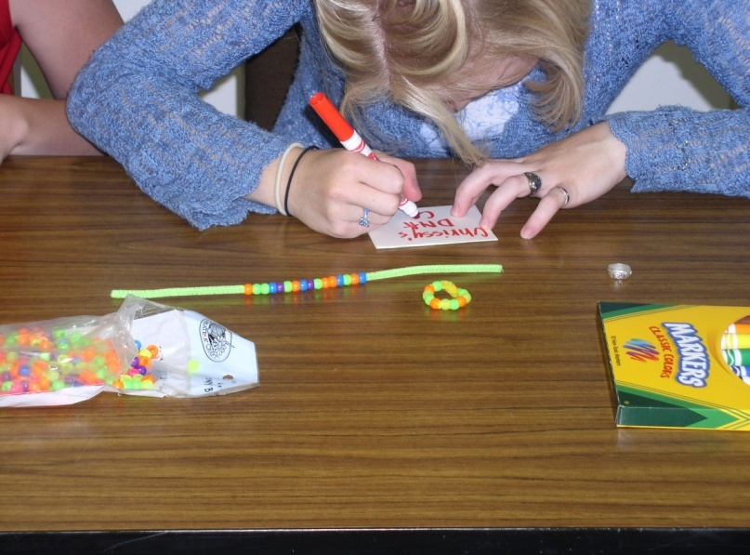
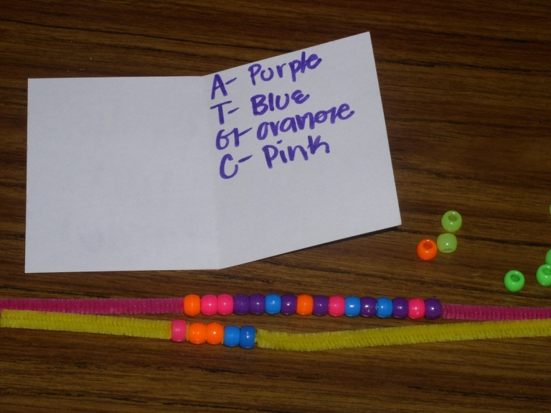
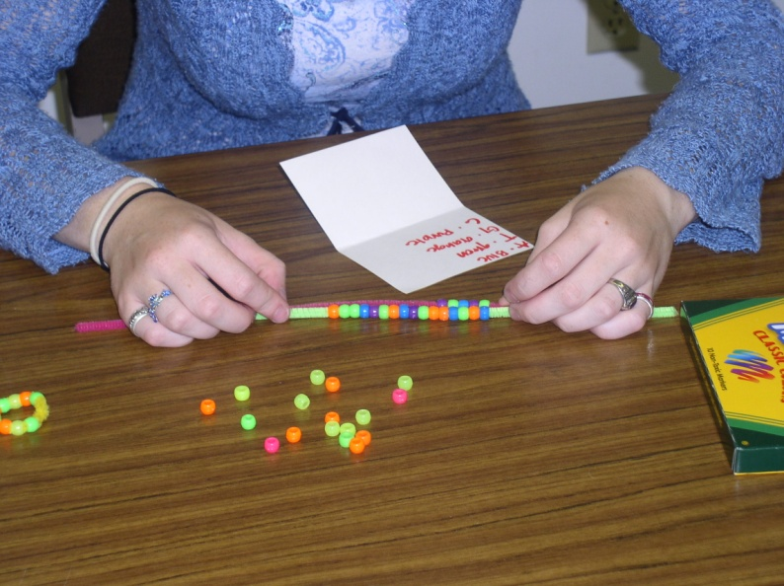
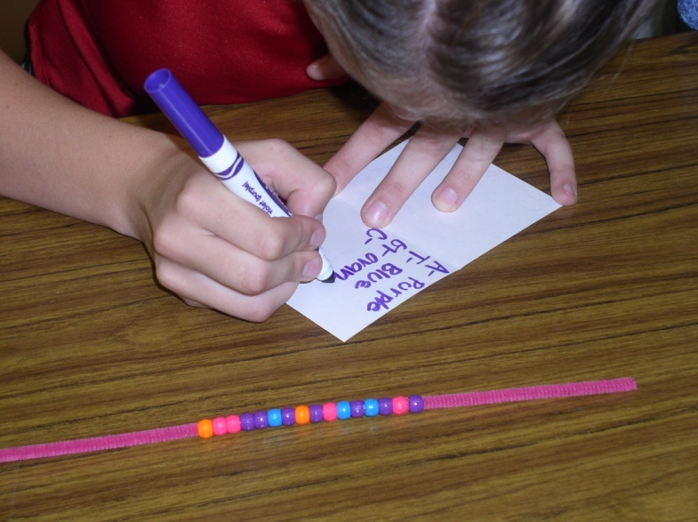
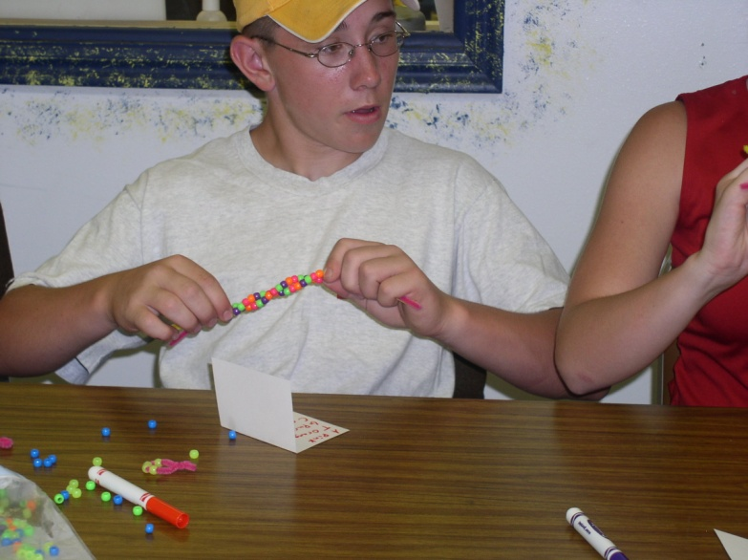
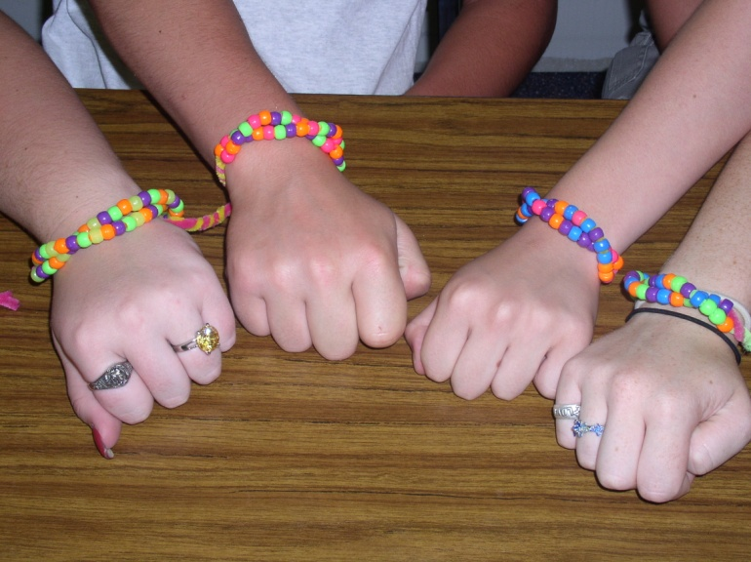
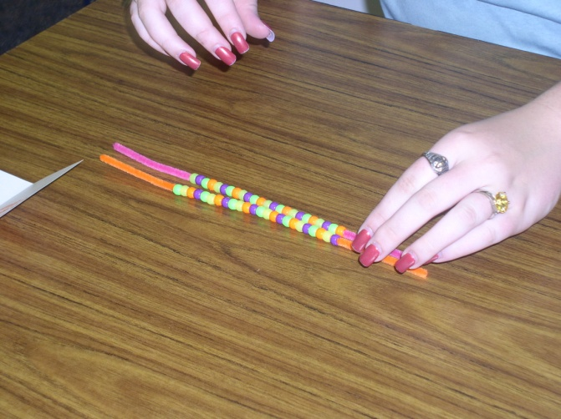

Slide 28
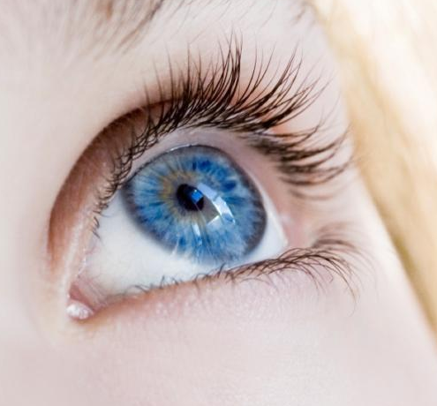
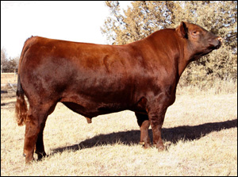
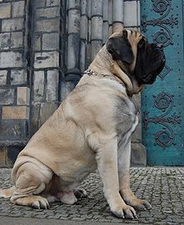
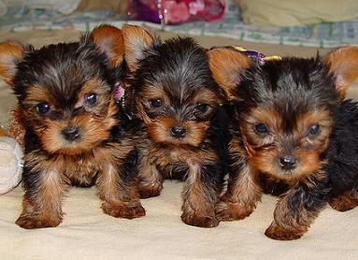
So…
How does a DNA strand become a trait??
Red Coat
Blue Eyes
Brown Hair
BIG
Small

Slide 29
Central Dogma of DNA
DNA makes RNA which makes PROTEINS

Slide 30
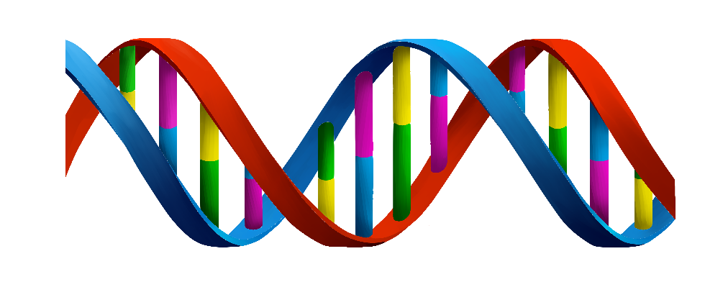
DNA vs RNA
DNA
Double stranded
A pairs with T
C pairs with G
RNA
Single stranded
A pairs with U
C pairs with G
(Uracil instead of Thiamine)
2 Kinds
(mRNA, tRNA)

Slide 31
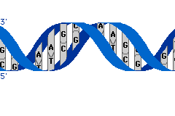
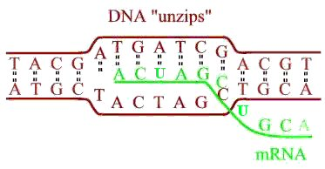
Transcription
Happens in the Nucleus
mRNA is formed
mRNA gets the code (message) from DNA to build a protein
U instead of T
Takes the code out of the nucleus to ribosome

Slide 32
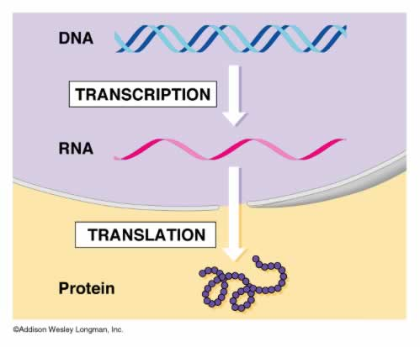
Messenger RNA (mRNA)
Takes coded information from DNA to the ribosomes
Remember… Ribosomes = protein factories

Slide 33
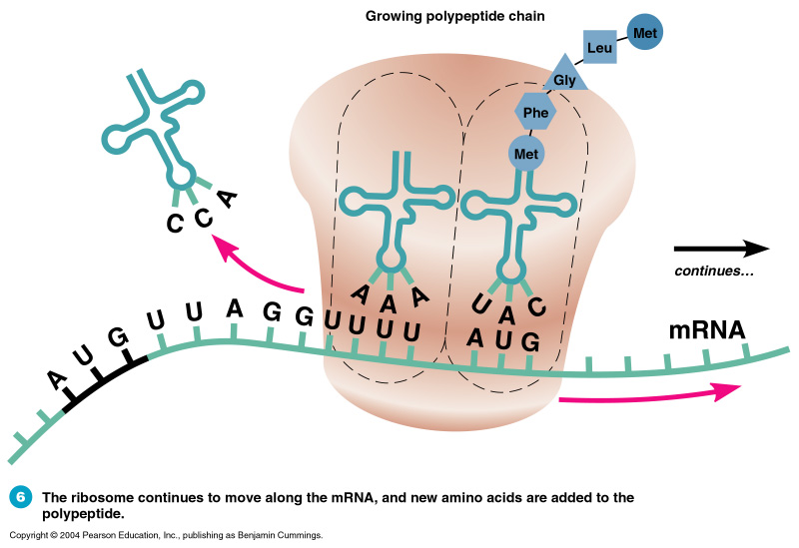
Translation
Happens in the ribosome
mRNA brings the code
tRNA “transfers” the correct amino acid

Slide 34
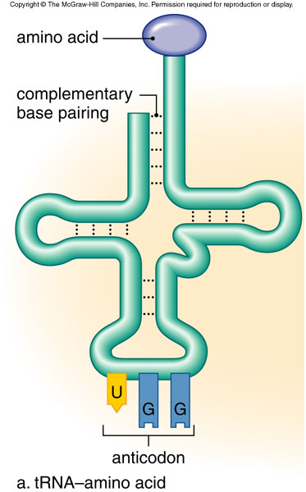
Transfer RNA (tRNA)
The RNA that CARRIES the amino acids to the ribosomes and PAIRS with mRNA

Slide 35
Amino acids bond together according to the code
Protein is built

Slide 36
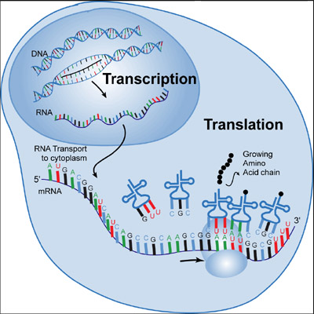

Slide 37
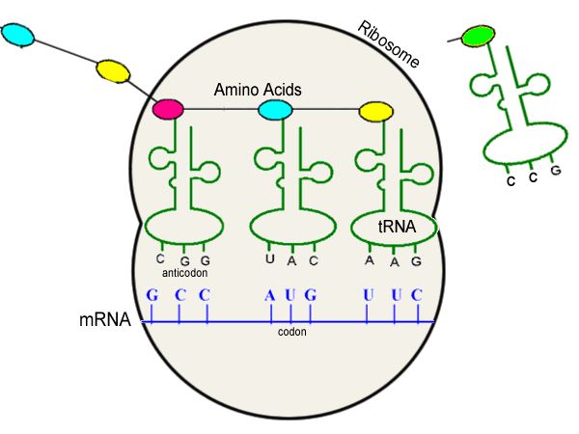
Transcription and Translation
DNA Stated Clearly-Review

Slide 38
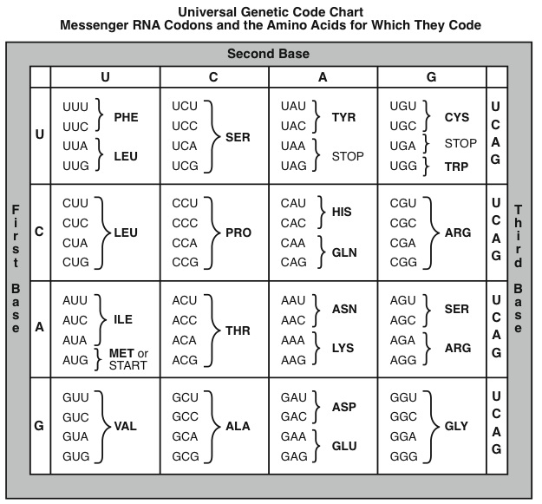
Codon
Combination of THREE bases of mRNA that determines the order of amino acids

Slide 39
DNA Trait
D. Describe the steps of translation and transcription in changing DNA into traits
DNA
mRNA
Transcribes
Proteins
Translation
Produce
Traits

Slide 40
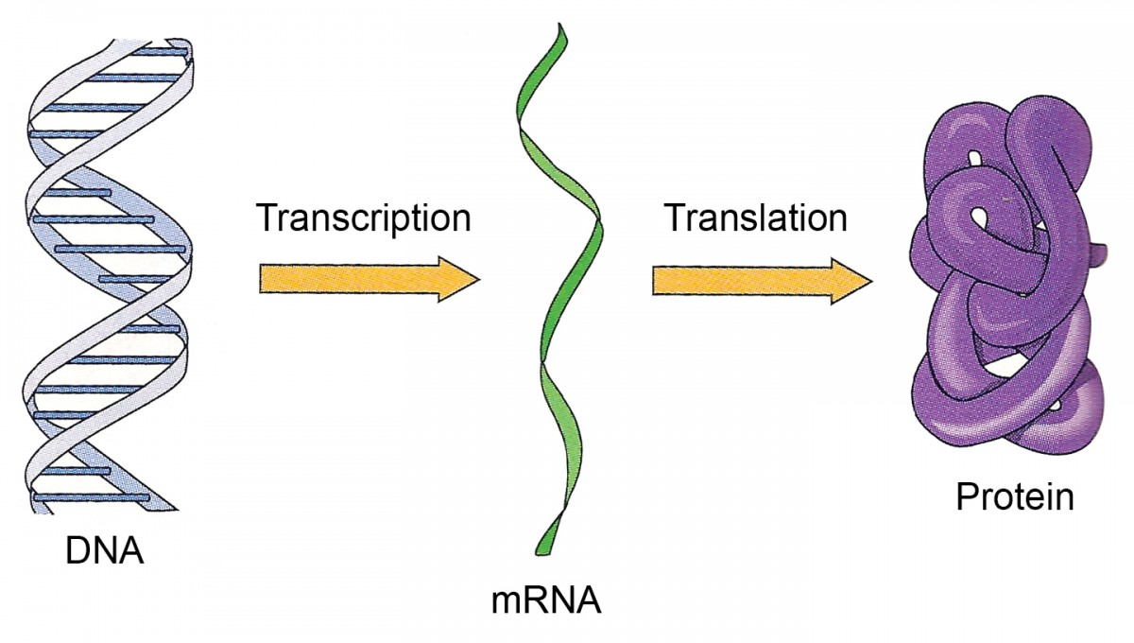

Slide 43
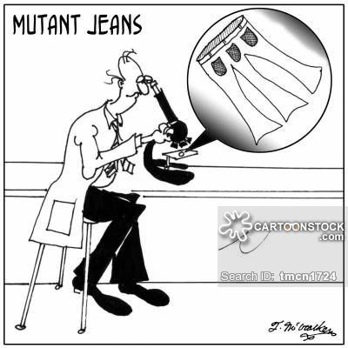
Types of Mutations
Point
Deletion
Insertion
Frame shift

Slide 44
Types of Mutations

Slide 46
Bell Quiz:
Name all 4 nitrogenous bases
What type of bond connects 2 base pairs in DNA?
Name the scientists that discovered the double helix model of DNA
What year was DNA discovered?
What are the sides of the DNA ladder made out of?

Slide 47
Bell Quiz:
1- What is translation?
2- What is transcription?
3- What is the difference between DNA and RNA?
4- Adenine pairs with__________
5- Cytosine pairs with__________.

Slide 48
Review for Test:
1- Who is Watson & Crick? What did they discover?
2- What is DNA? Where is it found? What does it stand for?
3-What makes up DNA? What does it look like?
4-What would be the complement DNA strand to the following:
ATTCGGCTA
5-What would a complement RNA strand look like for the following:
ACGAAGCAA

Slide 49
Review for Test:
6- What is a codon?
7-What is the difference between the DNA of a mouse and a cat?
8-What makes up a nucleotide?
9-What do ribosomes do?
10-What is the difference between RNA and DNA?
11-Where is DNA found?
12-What is transcription?
13-What is translation?
14-What is replication?

