Slide 1
Classroom Procedures & Disclosure

Slide 2
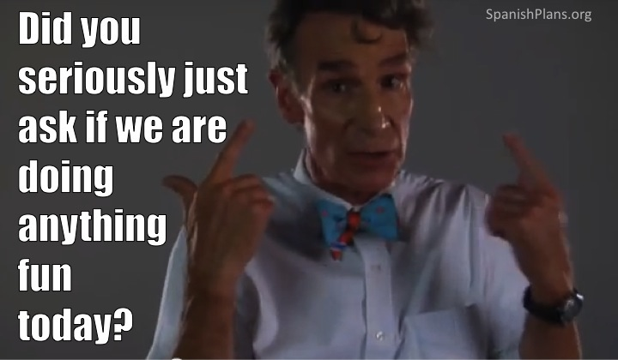

Slide 3
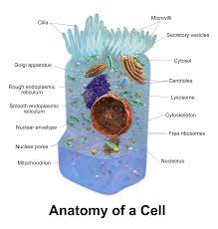
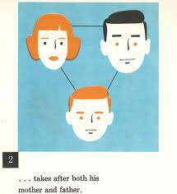
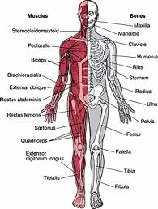
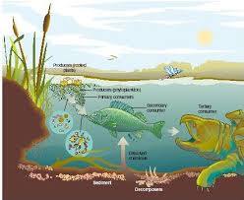
BIOLOGY What is it?
The study of life!
We cover 5 major standards this year:
CELLS --- GENETICS --- EVOLUTION --- ORGAN SYSTEMS --- ECOSYSTEMS

Slide 4
Materials
WRITING UTENSIL
Notebook
Chemistry Book
Scientific Calculator
(And NO you can’t just use your phone)

Slide 5
EXPECTATIONS
BE HERE
BE ON TIME
BE PREPARED

Slide 6
CLASS RULES
BE KIND AND ENCOURAGING
BE CURIOUS
ASK QUESTIONS
WORK HARD
HAVE FUN!

Slide 7
QUIET SIGNAL
BELL
5-4-3-2-1

Slide 8
Lab Fee/Textbook
Yes, you need your book EVERY day!

Slide 9
JOURNAL
EVERY DAY AT THE BEGINNING OF CLASS
FIRST 5 MINUTES
ONLY WAY TO GET FULL POINTS IS TO BE HERE AND BE ON TIME
JOURNAL CHECKS ABOUT EVERY 4 WEEKS

Slide 10
CLASS WEBSITE
www.stantscience.weebly.com
Find:
Missing Assignments
Journals
Due Dates
Class Notes and PowerPoints
Test Reviews

Slide 11
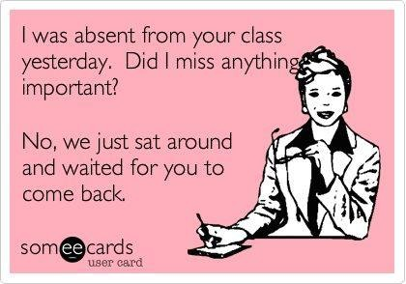
ATTENDANCE/MAKE UP WORK
CHECK CLASS WEBSITE
CHECK THE FILE BOX
SEE ME FOR QUESTIONS!

Slide 12
RETAKE POLICY
For all tests, the following policy will be in place.
If the you earn 80% or above, the retake* is optional.
If the you earn 60-80%, the retake is optional AND revisions are required.
If you earn below 60%, the retake AND revisions are required. Your score will be a zero until you retake the test.
* Re-take tests MUST be taken within 2 WEEKS of the original test and will be different than the original test.

Slide 13
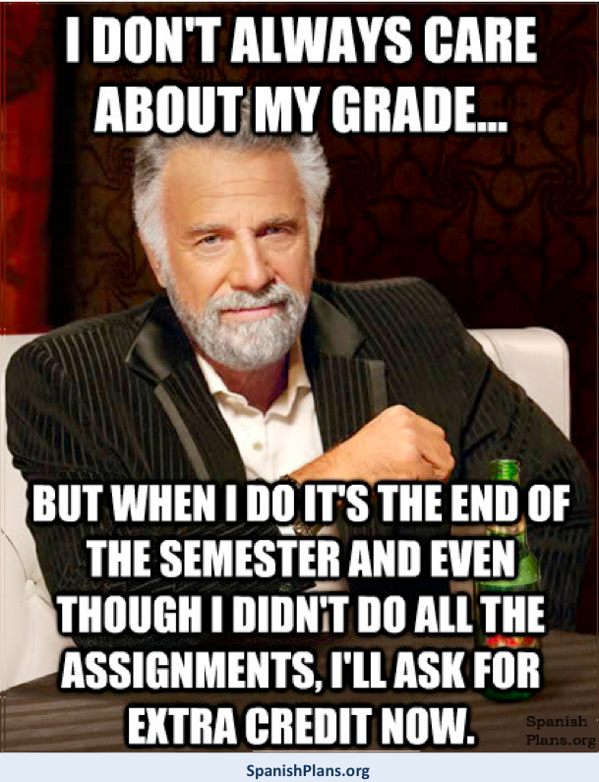
GRADING/ LATE WORK
Check your grade on POWERSCHOOL regularly
If you miss a day you get 2 extra days to turn in assignments that you missed.
Late assignments will get an automatic 10% grade reduction.
Assignments more than 2 weeks late will get an automatic 20% grade reduction.
So….turn in your stuff ON TIME!!

Slide 14
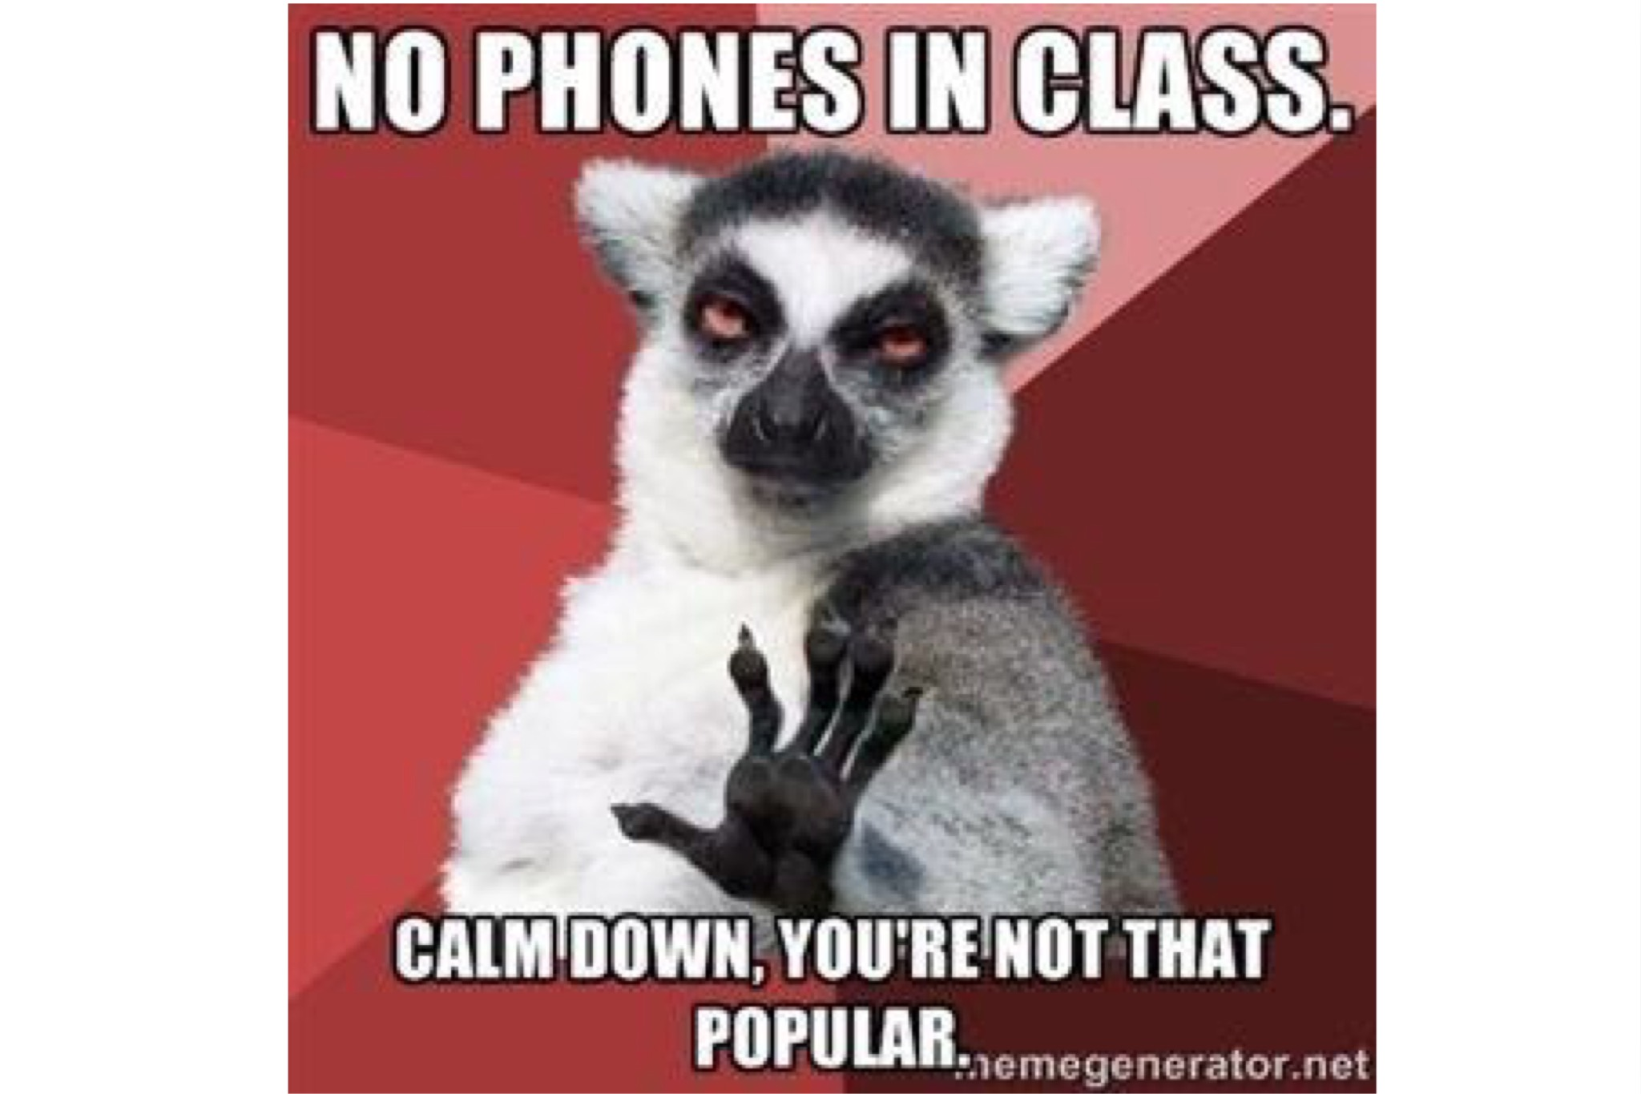
BEHAVIOR

Slide 15
THE PHONE CART
You will each be assigned a number
When you come into class you will put your phone/iPod/tablet…whatever on that space
I will use this to take attendance
If you tell me you don’t have a phone and I see you with one I will take it and send it to the office for the rest of the day….Be HONEST!

Slide 16
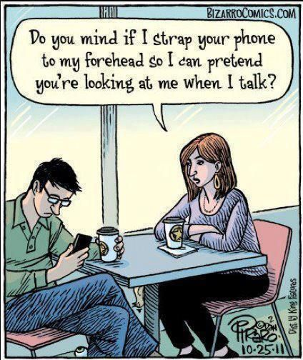

Slide 17
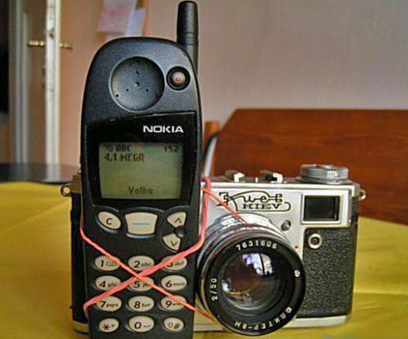
PVHS ACCEPTABLE USE POLICY
Lots of words that essentially mean:
Do not EVER take a picture or video of another student or teacher without their PERMISSION!
I WILL STRICTLY ENFORCE THIS!!

Slide 18
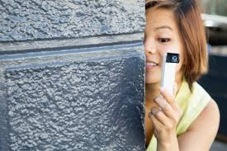
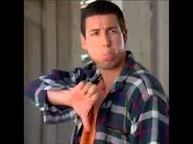
In other words….
Good
Bad

Slide 19
NEED HELP???
I am available in my classroom for help
At lunch on select days (Never Friday. Let me know if you plan to come in)
After school until 3:30

Slide 20
BIRTHDAYS

